Slide 1

ASLA Exhibitor Webinar
April 16, 2026

Slide 2

AGENDA
*This session is being recorded*
Kick-off
Introduction of ASLA team and service providers
Introduction to Exhibitor Kit & Exhibitor Resource Page
Open Q&A

Slide 3
ASLA Team
ASLA Team
Daniel Martin, Managing Director, Development
Monica Barkley, Sales Manager
Kathleen Thomas, Sales Manager
Robert Reed, Sales Manager
Judy Mehlman, Manager, Development
Michelle Mobley, Manager, Expo & Sponsorships
Lydia Thompson, Manager, Marketing & Market Development
Freeman Team (General Contractor)
Matt Bradley, Mikeighla Droney, and Joanne Peau
LA Convention Center (LACC)
Sarah Prom and Carisa Norton

Slide 4

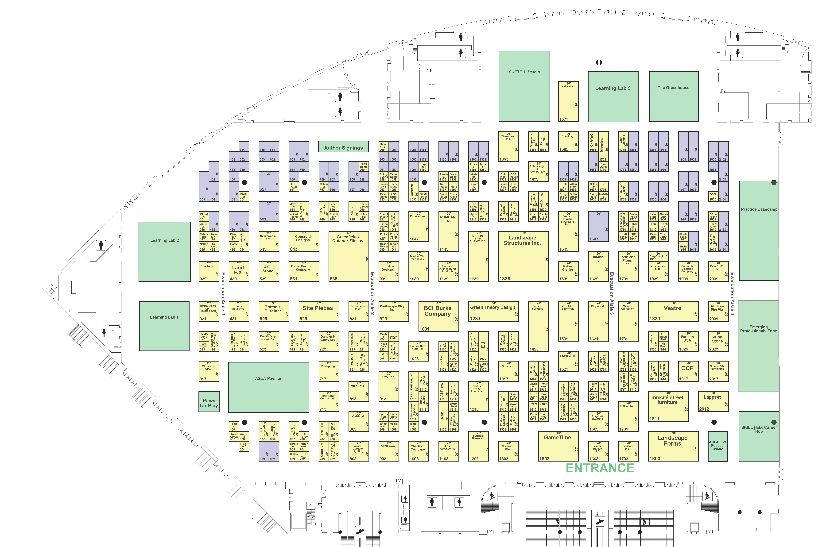
What’s New at EXPO
Engaging additions to build excitement
ASLA Live Podcast Studio
SKILL | ED Career Hub
The Greenhouse
Learning Lab #3
Revised Bookstore Space

Slide 5
Important Links
Exhibitor Resources Page
Attendee Website
Online Exhibitor Kit – Freeman
Registration & Housing Customer Service for ASLA exhibitors Email: ASLAexhibitor@maritz.com Phone: (864) 208-0397 (available Monday-Friday 9am–5pm EST)
Freeman Services Exhibit Customer Service
Phone: US or Canada: 888-508-5054 | International 1-817-210-4869
Call or text: Mon-Thursday 7am-7pm CT, Fri 7am-5pm CT Email for service.
Get a shipping quote through this link.

Slide 6
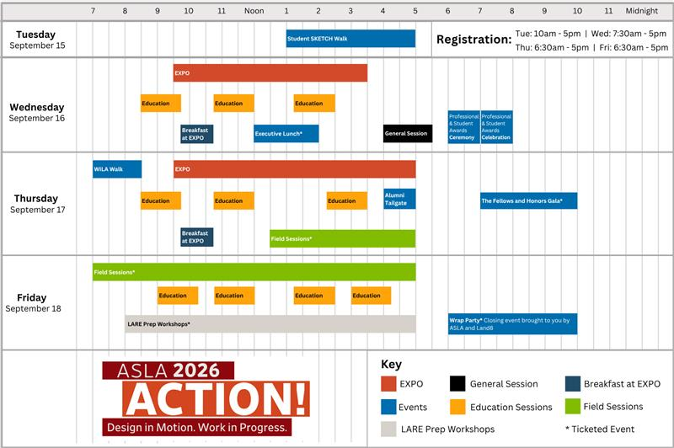
Schedule-at-a-Glance
Available at www.aslaconference.com

Slide 7
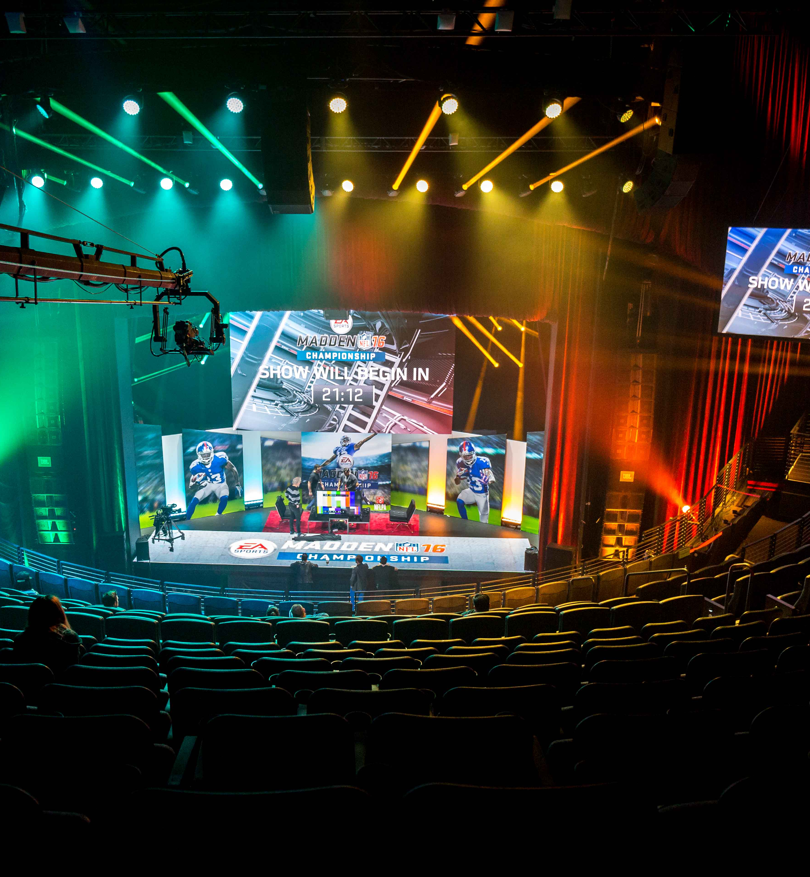
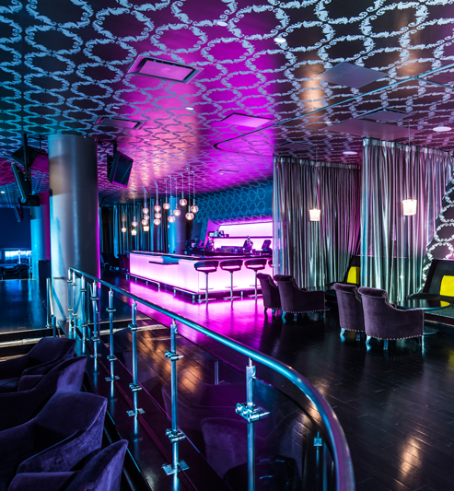
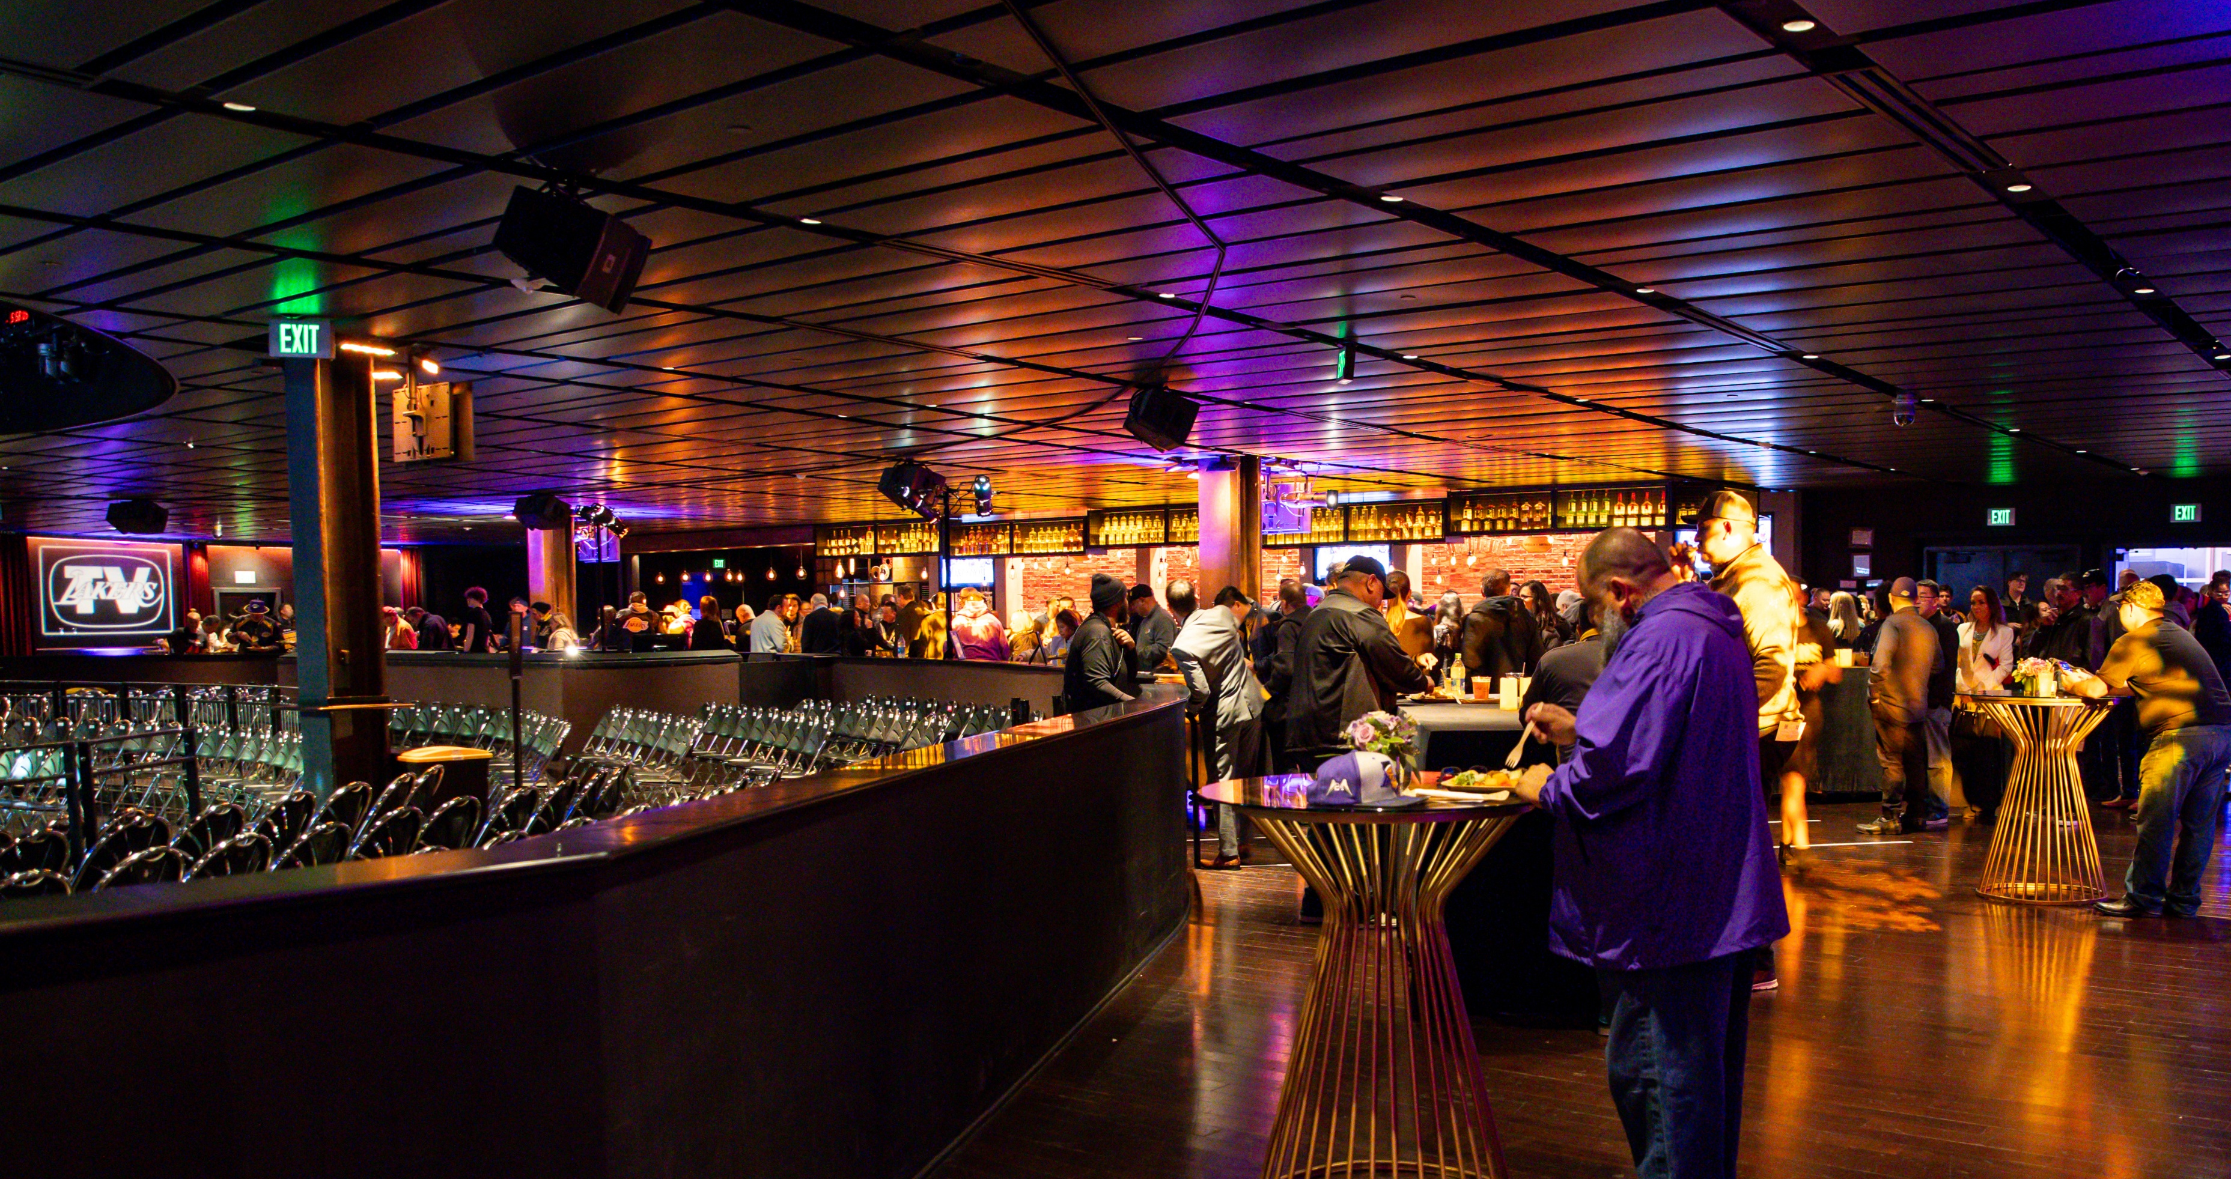
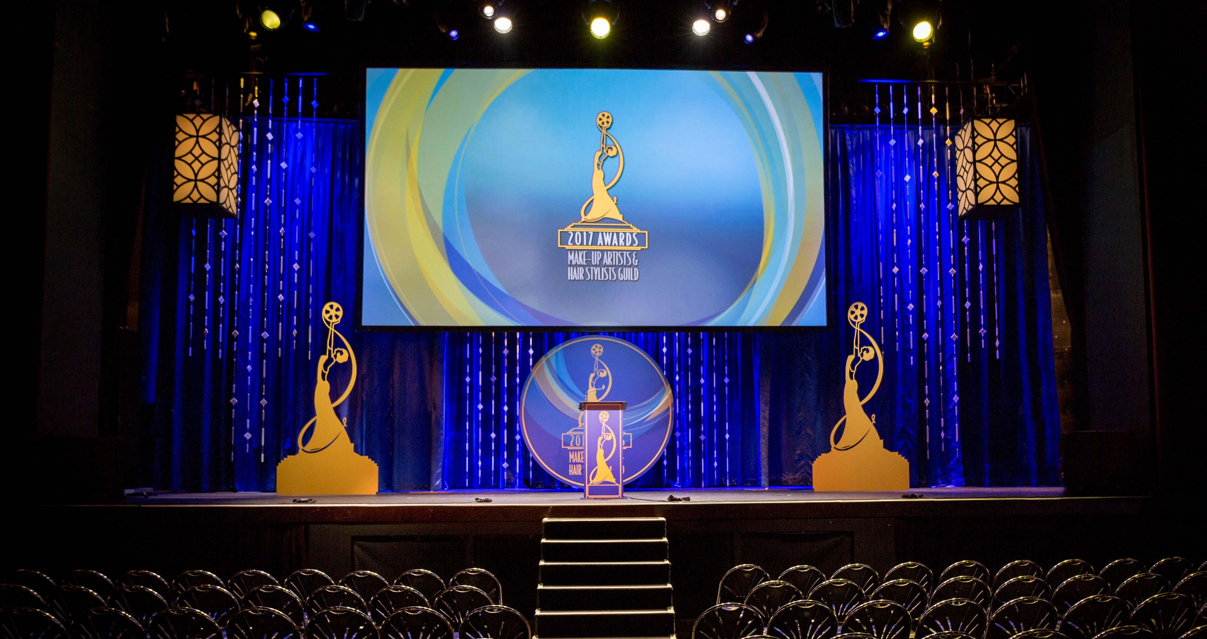
General Session + Awards
The Novo Theater

Slide 8
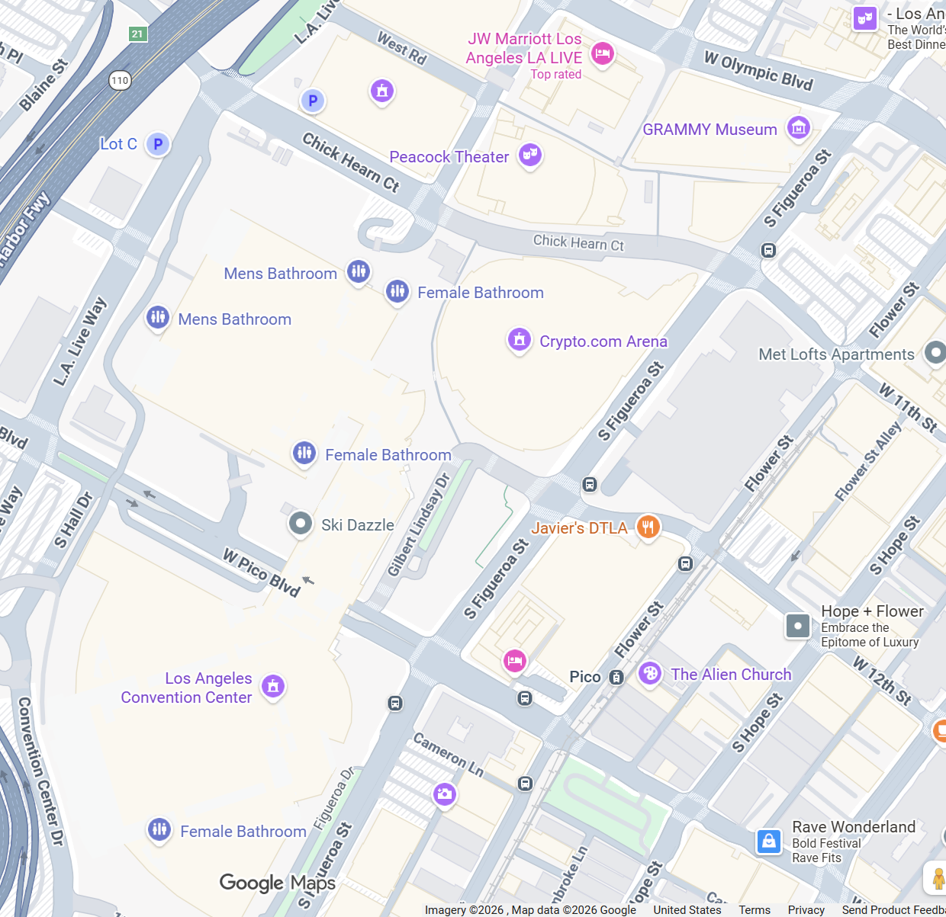
Location / Venues
Los Angeles Convention Center + JW Marriott LA Live
Dates: Wednesday, September 16 - Friday, September 18
Location:
Los Angeles Convention Center
1201 South Figueroa Street
Los Angeles, California 90015
10-minute walk between LA CC and JW Marriott LA Live

Slide 9
Register Your Team
Register your staff in advance and avoid the lines. When you register your team they will receive a confirmation email with a barcode. The barcode allows them to skip the onsite registration line. They can simply scan and go to receive their name badge. A name badge is required to enter the EXPO hall with no exceptions. If you need to purchase additional badges beyond your allotment you can find registration rates on the conference website.
Key Dates
Week of April 27 registration launch with discounted hotel room blocks. Please note our official registration partner is Maritz.
Early Bird Rate ends June 15, 2026
Advanced Rate ends August 4, 2026
Onsite Rate Begins August 5, 2026

Slide 10
Code of Conduct
The American Society of Landscape Architecture (ASLA) Code of Conduct for Live and Virtual Conferences and Events.
ASLA is committed to fostering a diverse and inclusive culture within our profession, where membership, leadership, staff, partners, volunteers, and other supporters can connect, learn, and grow. The ASLA Code of Conduct for Live and Virtual Events emphasizes the importance of treating all participants with dignity and respect, prohibiting unacceptable behaviors such as bullying, harassment, and discrimination based on various identities. It provides examples of unacceptable conduct and outlines procedures for reporting such behaviors, ensuring confidentiality and prompt responses. Consequences for failing to comply with requests to stop unacceptable behavior include possible removal from the conference without warning or refund.
Full version will be available on the Exhibitor Resources page.

Slide 11
Booth Plan and Permits
Avoid any Delays or Issues During Set-up. All exhibitors, regardless of booth size, must follow IAEE booth construction guidelines. You can find a copy of the guidelines on the Exhibitor Resources Page.
If your booth includes a structure that is 12 ft or higher, you are required to secure a permit from the City of Los Angeles and have your booth plans reviewed and approved. We’ve provided a document to guide you through this process on the Exhibitor Resources Page—please download and review it carefully.
Playground equipment is excluded
Hanging signs is excluded
Additionally, any booth 200 sq ft or larger must still be submitted for plan review by
July 1, 2026 and approval. You can upload your booth plan on the Exhibitor Resources page.

Slide 12
Booth Notes
You are required to have the floor covered in your exhibit space. Please order carpet in advance if needed from Freeman. The order form is located in the exhibitor kit. If floor covering is not placed in your booth by noon on Tuesday, Freeman will provide carpet and your company will be charged the onsite carpet rate.
If you have a booth 20x20 or larger and require a hanging sign, the fee is $500 + labor to install and dismantle the sign. Reach out to your sales manager to finalize.
Do you plan to host food and beverage in your booth? If so, you must complete a booth entertainment form and submit it for approval. Catering menus are located in the Exhibitor Kit. No food and beverage from outside the center is permitted.

Slide 13
Certificates of Insurance
Please note the following critical information:
Deadline for Approval: Your compliant Certificate of Insurance must be received and approved no later than Monday, August 10, 2026.
Automatic Policy Purchase: If your insurance certificate has not been approved by the deadline, a policy will be purchased on your behalf at a rate of $199.00. This fee will be billed directly by ASLA and must be paid in full to ASLA.
Access Restrictions: Payment of this fee is mandatory prior to any of your employees obtaining conference badges or entering the EXPO show floor.
Submit your certification of insurance to sales@rainprotection.net.

Slide 14
Company Profile Live Now.
Your company profile is live on our website as soon as your booth is assigned.
We encourage you to update your profile as soon as possible so future attendees can learn more about your company and the products or services you provide. To update your listing, download this step-by-step guide. Please follow instructions for the “forget password” the first time you access the platform.
Keeping your profile UpToDate helps attendees connect with you and ensures you get maximum visibility leading up to the event.
Once you have access to your dashboard, you will be able to navigate to “My Account” to review payment details or make outstanding payments in the future.

Slide 15
Union Labor
If your exhibit preparation, installation or dismantling requires more than 1 hour, you must use union personnel supplied by the Official Decorating Contractor.
As an exhibitor, you will be pleased to know that when union labor is required, you may provide your company personnel to work along with a union installer in Southern California on a one-to-one basis.
2026 Union Labor Rates
2026 SoCal Labor Rules
Material Handling - $2.01 per pound
Material Handling (after the deadline of August 17) - $2.52 per pound.
Special material and handling rates are offered for stone, trees, and publishers.

Slide 16
EXPO Hours
EXPO
Open to Attendees | Wednesday, September 16 | 9:30am – 3:30pm
Open to Attendees | Thursday, September 17 | 10:00am – 5:00pm
EXPO Set-up/Dismantle
Set-up | Monday, September 14 | 8:00am-5:00pm
Set-up | Tuesday, September 15 | 8:00am-5:00pm
Dismantle | Thursday, September 17 | 5:00pm-11:00pm
Dismantle | Friday, September 18 | 8:00am-5:00pm

Slide 17
Join Us!
Exhibitor Only Events
Exhibitor Happy Hour Tuesday, September 15 4:00pm-5:00pm
Wait for the Crate Party Thursday, September 17 5:00pm-7:00pm
Don’t Miss!
Alumni Tailgate Party Thursday, September 17 3:30pm-5:00pm

Slide 18
Exiting the Event
Would you like to donate materials from your booth to Habitat for Humanity? You will be required to secure a material handling form unique to the donation partner. Following the shows closing, Freeman will collect all labeled items for donations. Labels are located in the in the Exhibitor Lounge/Sales Office at the EXPO. There will be new guidelines distributed this year, please be aware of these before submitting donated items.
Please do not break your booth down early. This will result in future penalties when you exhibit with us in future conferences. Breakdown starts at 5pm.

Slide 19
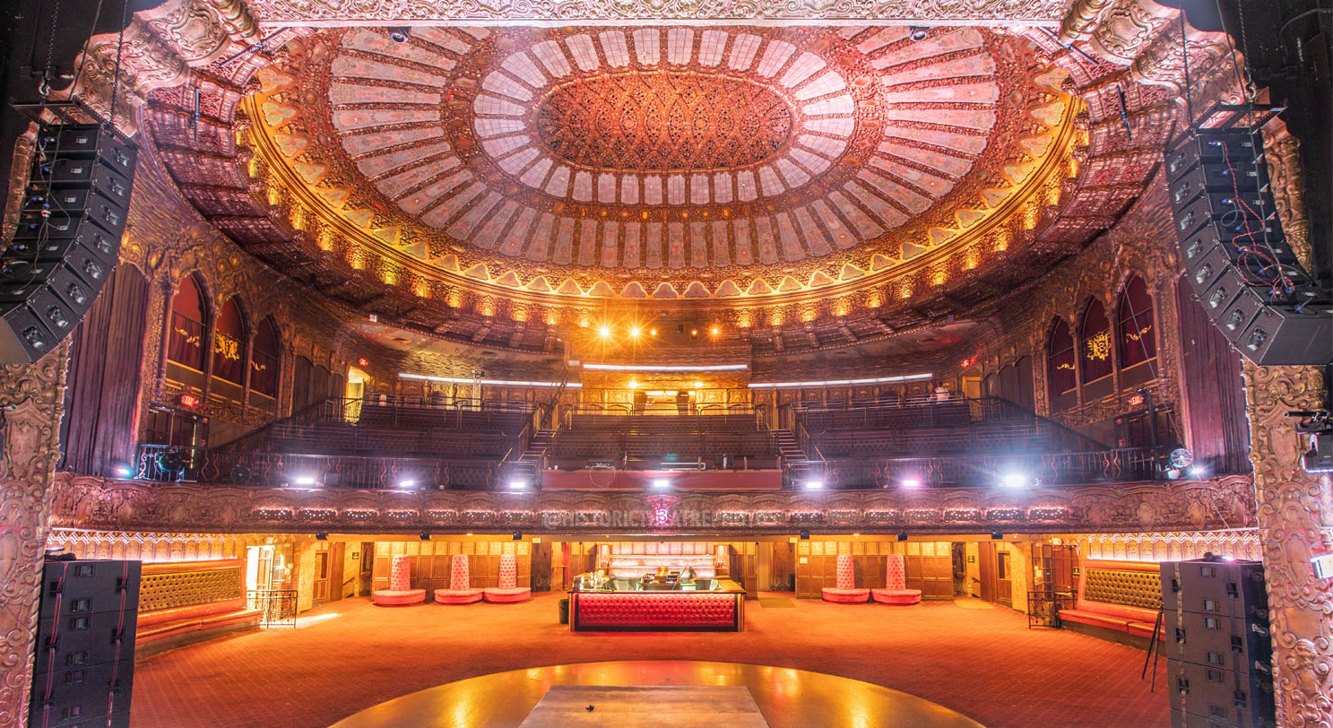
Land8 Wrap Party
Finishing with a bang

Slide 20
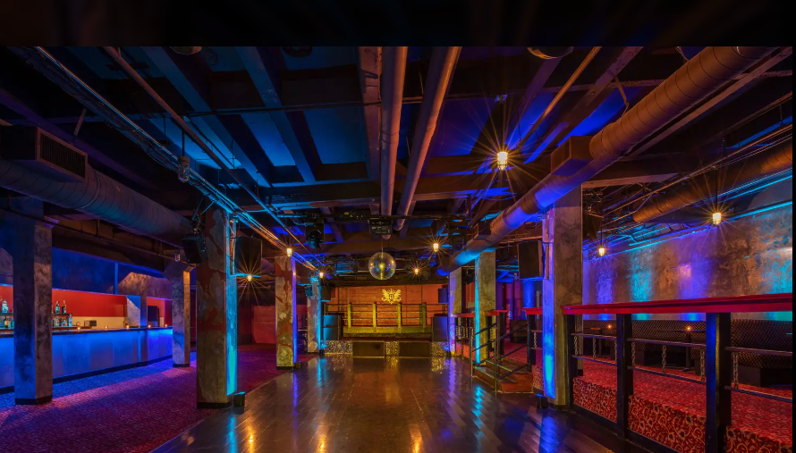
Land8 Wrap Party
Land8 Wrap Party
Finishing with a bang
The Chamber

Slide 21
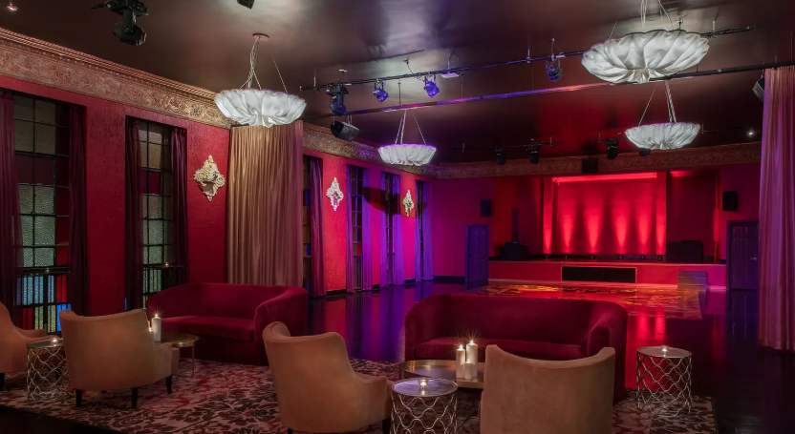
Land8 Wrap Party
The Sanctuary

Slide 22
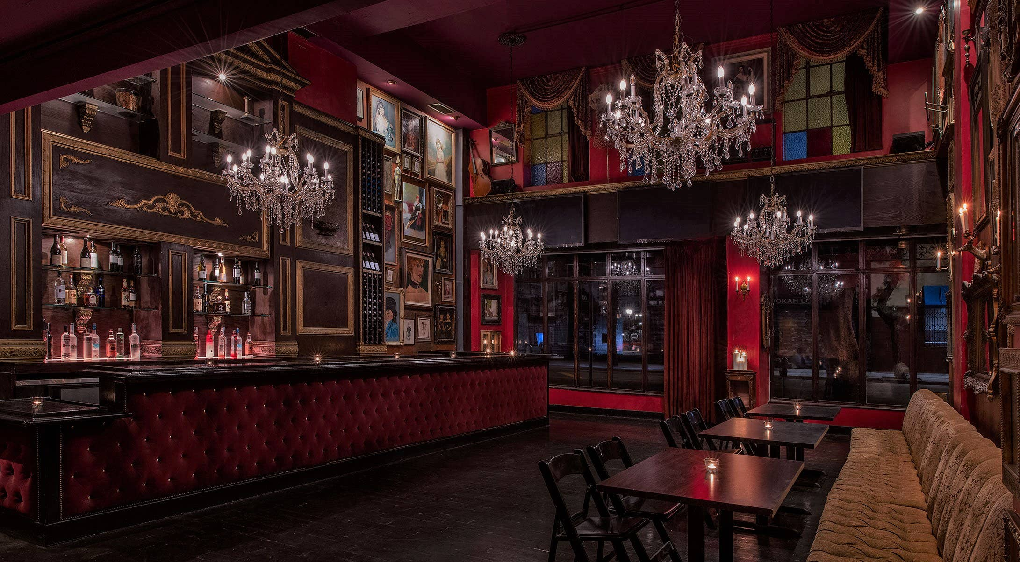
Land8 Wrap Party
The Confessional

Slide 23
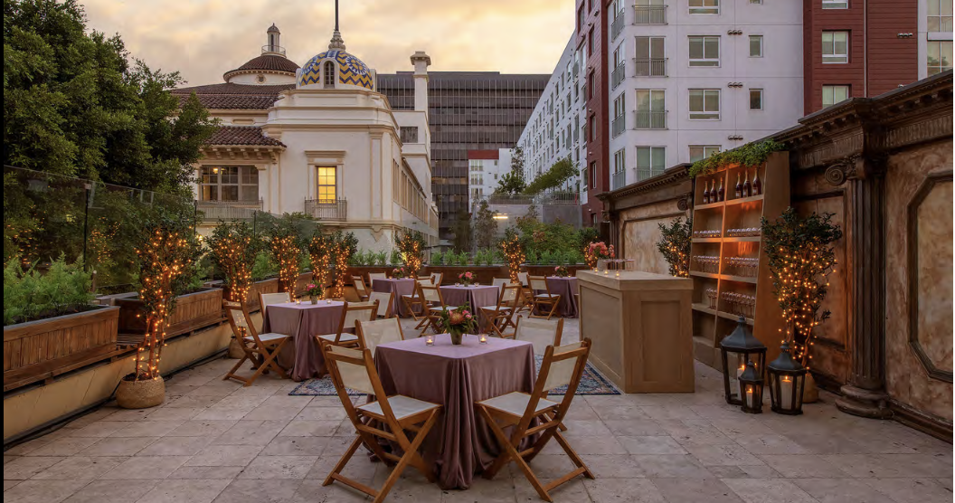
Land8 Wrap Party
The Terrace

Slide 24
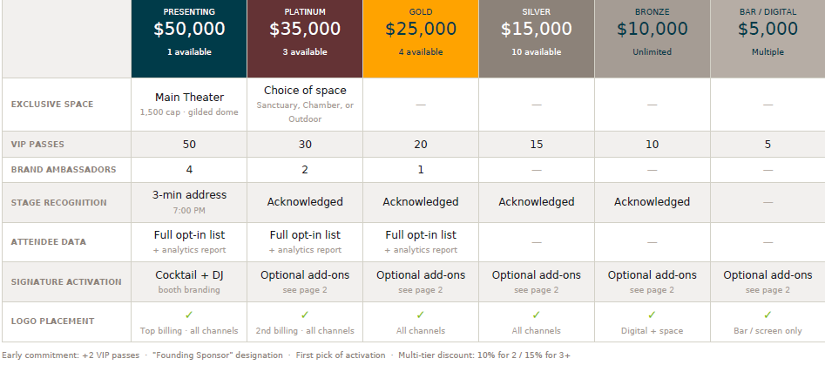
Wrap Party Sponsorship Opportunities

Slide 25
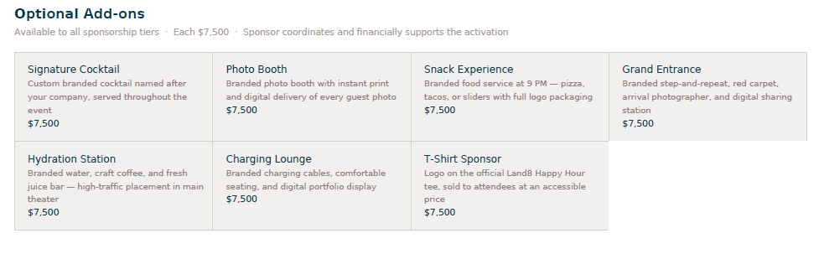
Wrap Party Sponsorship Opportunities

Slide 26
THANK YOU!
SALES MANAGERS
Monica Barkley
Sales Manager
barkley@asla.org
Kathleen Thomas
Sales Manager
kthomas@asla.org
Robert Reed
Sales Manager
Rreed@asla.org
EXPO MANAGER
Michelle Mobley
Exhibit Manager
202-489-0502
mmobley@asla.org
Registration & Housing Customer Service for ASLA exhibitors Email: ASLAexhibitor@maritz.com Phone: (864) 208-0397 (available Monday-Friday 9am–5pm EST)

